Slide 1
Recell- Predicting prices for used phones
Supervised Learning Foundations
22nd September 2022

Slide 2
Contents / Agenda
Executive Summary
Business Problem Overview and Solution Approach
EDA Results
Data Preprocessing
Model Performance Summary
Appendix

Slide 3
Executive Summary
The novelty of buying and selling refurbished/used phones and tablets has worn off over the years leading to an uptick in the growth of market for these devices. This is largely because of the many cost-effective alternatives which refurbished and used devices provide as when compared to buying new devices. Recell, a start-up company has provided recent 2021 data to analyse and establish dynamic pricing strategy for these refurbished/used devices and also identify factors that influence it.
The analysis was carried out and the following deductions were made:
Our linear assumptions were met
Our model is able to explain 84% of the variation in the data.
The train and test RMSE and MAE are low and closely comparable which signifies that our model is not suffering from overfitting.
Please mention actionable insights & recommendations

Slide 4
Executive Summary
The MAPE on the test set suggests that we can predict within 4.5% of the normalised price of used devices.
The MAE is 0.18 which means that our model can predict normalised prices for used phones with a mean error of 0.18 on our test data.
Our training R-squared and Adjusted R-squared are 0.84.
Conclusions and Recommendation
Based on the successful satisfaction of our assumptions, we can conclude that the model is good for both prediction and also inference purposes.
Holding every other variable constant, a unit increase in the screen size of the refurbished device will increase the normalised price for used device by 0.0433 units.
If the main camera mp of the used/refurbished devices increases by one unit, then the normalized price for the used device will increase by 0.0189 units, all other variables held constant.

Slide 5
Executive Summary
If the selfie camera mp of the refurbished/used device increases by one unit, the normalised price for the refurbished device will increase by 0.0131 units, all other variables held constant.
If the ram of the devices increases by one unit, the normalised price for the used device will increase by 0.0172 units, all other variables held constant.
Holding every other variable constant, a one unit increase in days used will increase our normalized price for used devices by 6.226e-05 units.
Holding every other feature constant a one unit increase in normalised price of a new device of the same model will increase the normalized price for used devices by 0.428 units.
Holding every other feature constant, a one unit increase in years since released will reduce our normalised used price by 0.0181 units. Recell should note that the longer the devices stay, their prices reduce as the years go by.

Slide 6
Executive Summary
Conclusions and Recommendations
Any device having 4g yes will increase the normalised price by 0.0369 more than device having 4g no.
Recell is advised to look into factors that influence the increase in our normalised used prices, such as the increase in normalised price of a new device of the same model leads to an increase in normalised price of refurbished device. Therefore, they can take advantage of this situation such that every time a company like Samsung starts marketing a particular model of phone, Recell can fill the markets with refurbished products of the same model and watch how customers will buy more of the used products.
Recell should market more devices with big screens, good camera resolution (front and rear) and RAM space as these factors affect prices of used devices positively.

Slide 7
Business Problem Overview and Solution Approach
ReCell, a startup company is taking advantage of the rising prices of refurbished or used mobile devices and has requested for the services of a data scientist to analyze the data provided, build a linear regression model to predict the price of a used phone/tablet then identify factors that significantly influence it.
Methodology
To explore the dataset and extract insights the following steps were carried out:
Imported the necessary libraries into our Google Colab.
Uploaded our dataset.
Carried out some sanity checks on our dataset to ensure the data was loaded properly.
Confirmed the presence of missing values and treated them accordingly.
Confirmed the absence of duplicated values.
Carried out Exploratory Data Analysis.
Carried out Outlier check using box plots

Slide 8
Business Problem Overview and Solution Approach
Methodology
Feature Engineering
Data preparation for modelling
Model building-Linear regression
Model performance check
Checking linear regression assumption and carrying out all appropriate test.
Final model summary
Actionable insights and conclusion

Slide 9
EDA Results
Dataset is made up of 3454 rows and 15 columns.
Columns are all in their preferred datatypes comprising 4 object, 9 float and 2 integers.
There were presence of missing values which were confirmed and further treated.
Memory usage: 404.9+ KB.
Statistical summary of variables shows the following :
The oldest used phone was released in 2013 and the most recent phone in 2020.
The longest number of days the refurbished phones have been used is/are 1094 days while shortest is/are 91 days.
The least normalized price for a refurbished phone is at 1.59 euros while the highest is at 6.6 euros with its average price at 4.4 euros while the least normalised price for new phone is 2.9 euros and highest price at 7.9 euros, it’s average price for new phone is at 5.2 euros.
Some of the phones had screen sizes as big as 31cm and as small as 5cm.
The resolution of the rear camera is higher than that of the selfie/front camera.
The battery consists of highest energy capacity at 9720 mAh and lowest at 500 mAh.

Slide 10
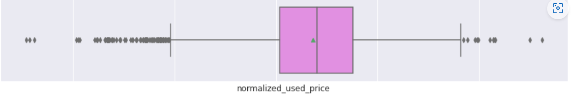
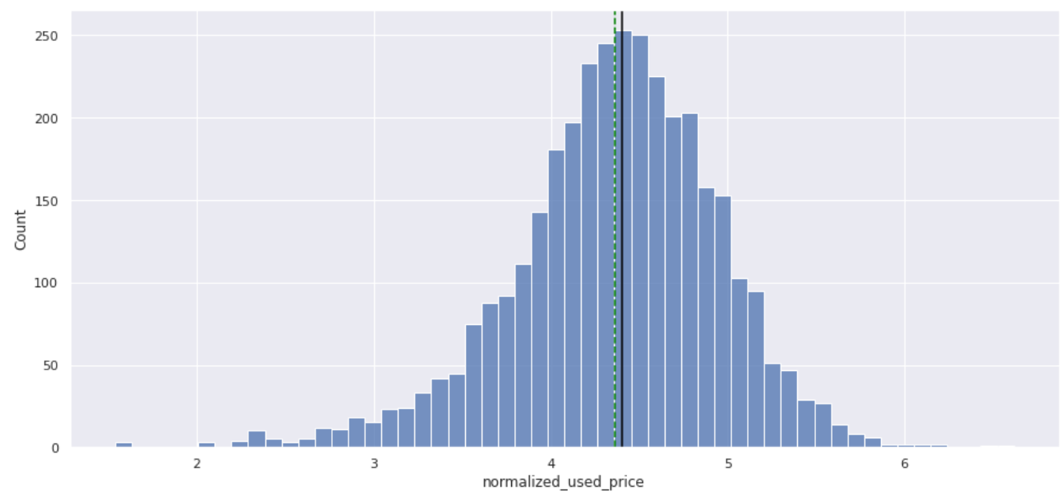
EDA Results
Univariate Analysis- Normalised Used Prices
The normalised used price plot looks close to being a fairly normal distribution and shows that average price for used phone to be at around 4.4 euros.
It however has a lot of outliers on both sides of the tail.

Slide 11
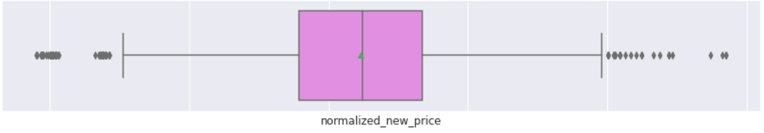
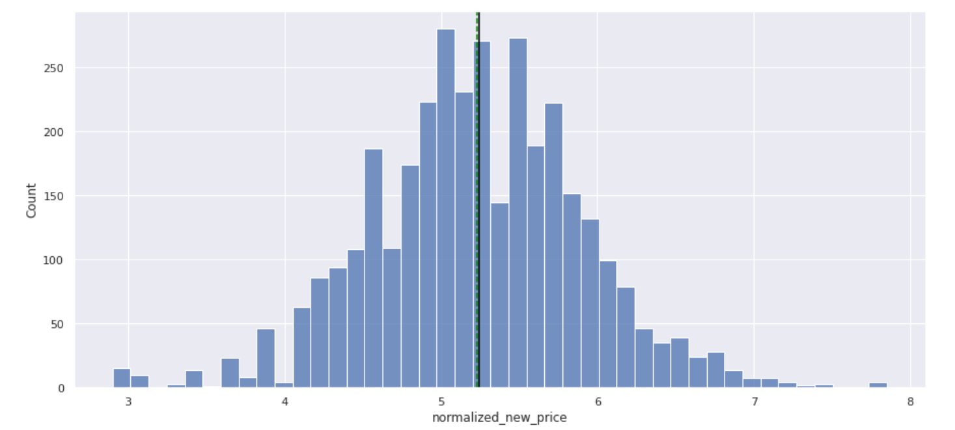
EDA Results
Univariate Analysis- Normalised New Price
The normalized new price plot looks like a fairly normal distribution with outliers on both sides.
The median and mean are closely spaced together.

Slide 12
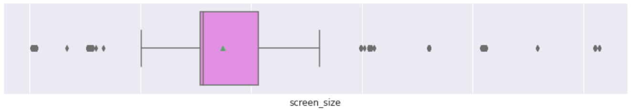
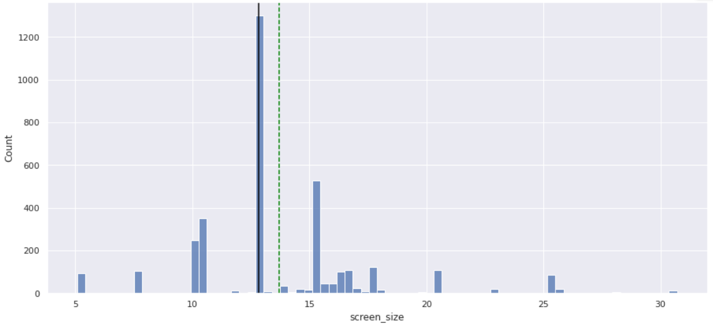
EDA Results
Univariate Analysis- Screen size
The distribution for screen size plot has outliers on both sides and appears to be slightly right skewed.
The plot shows an average screen size of 13.7cm while the median is at 12cm.

Slide 13
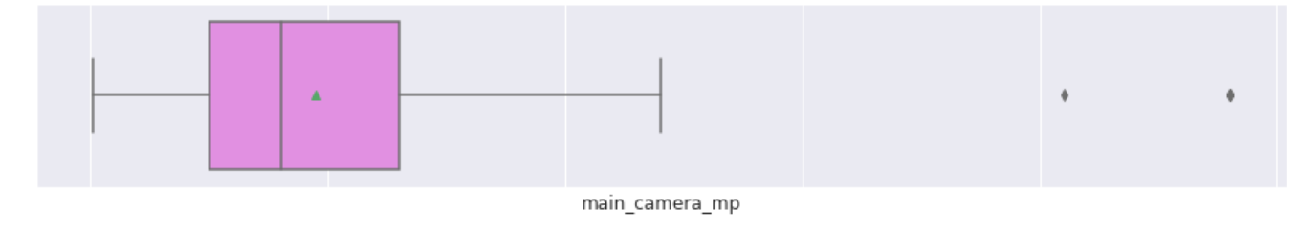
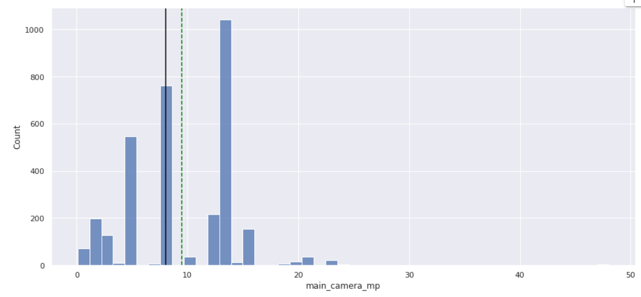
EDA Results
Univariate Analysis- Main Camera mp
This histogram-barplot for Main Camera mp is right skewed and contains a couple of outliers at the far end of the right tail.
The average value of the main camera is at about 9.6 megapixels.

Slide 14
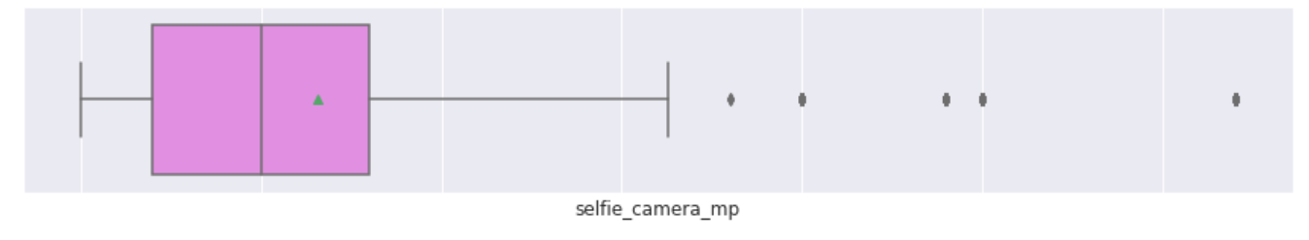
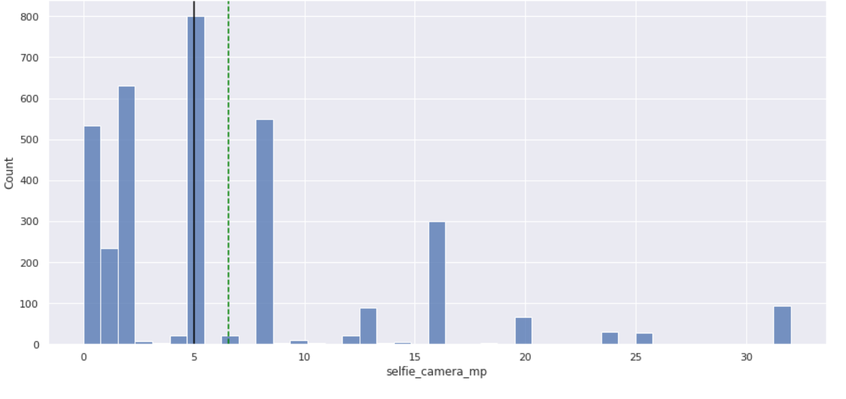
EDA Results
Univariate Analysis- Selfie Camera mp
This histogram-barplot for selfie camera Mp is right skewed and contains some outliers at the far end of the right tail.
The median resolution is at 5megapixels
The average value of the selfie/face camera resolution is at about 6.6 megapixels.

Slide 15
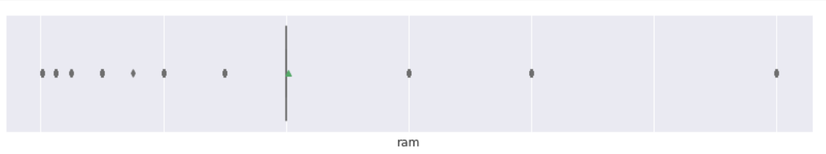
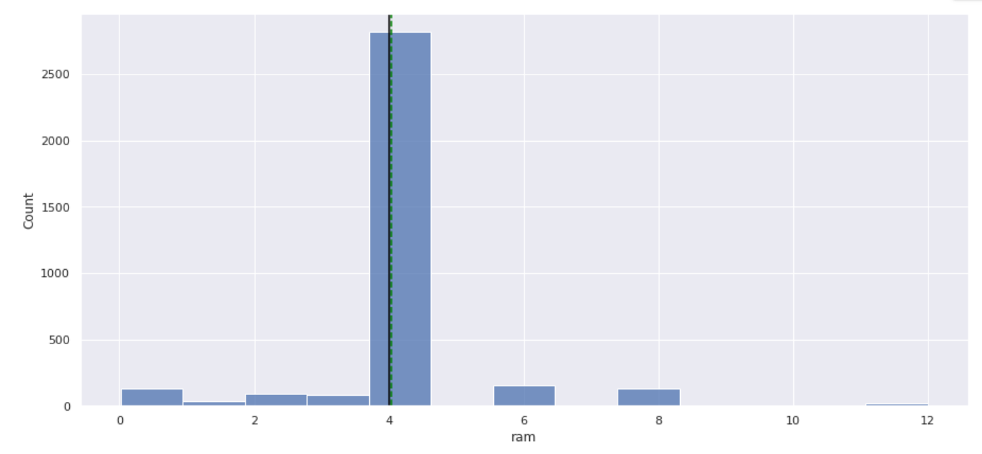
EDA Results
Univariate Analysis- ram ram
The distribution for ram is completely filled with outliers on both sides.
There is a visibly huge spike of used phones which have 4GB ram.
The median and mean are both on 4GB and we have used phones exceeding more than 2500 counts.

Slide 16
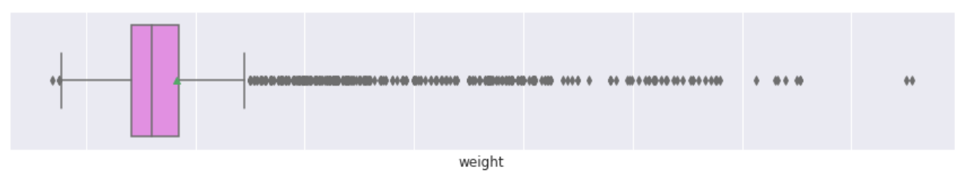
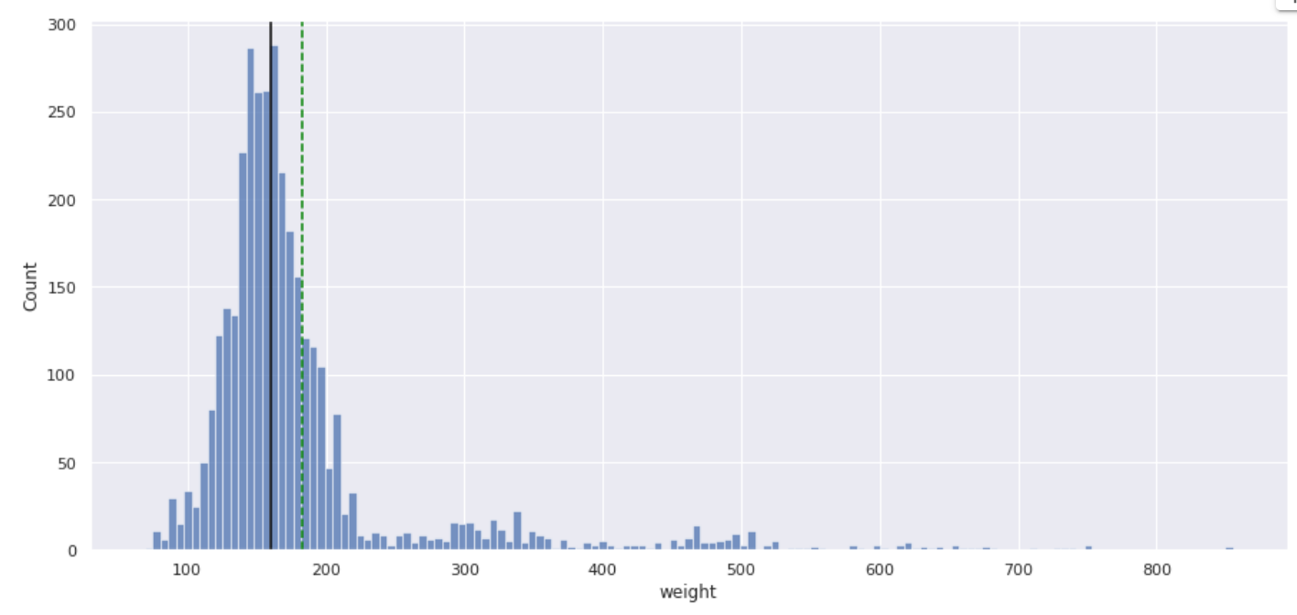
EDA Results
Univariate Analysis- Weight Weight
The distribution for weight is heavily filled with outliers on the right side of the tail
The average weight of the used phones are at about 183grams

Slide 17
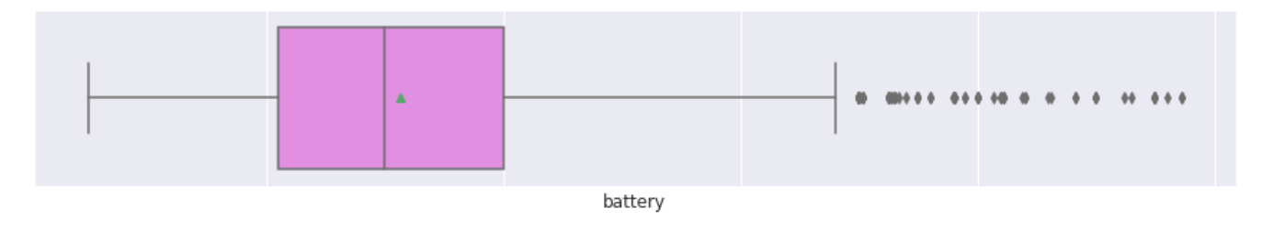
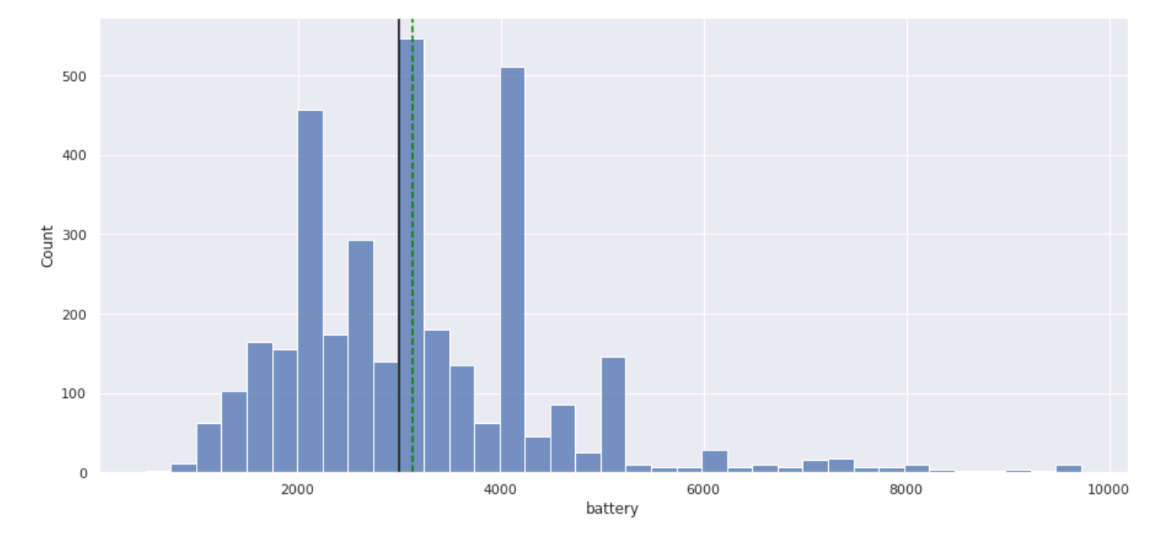
EDA Results
Univariate Analysis- Battery
The distribution for battery is heavily filled with outliers on the right tail.
Also the plot appears to be skewed on the right .

Slide 18
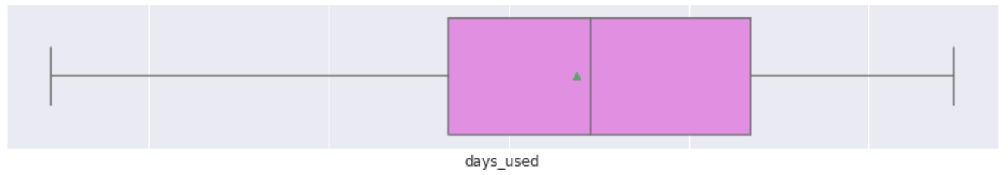
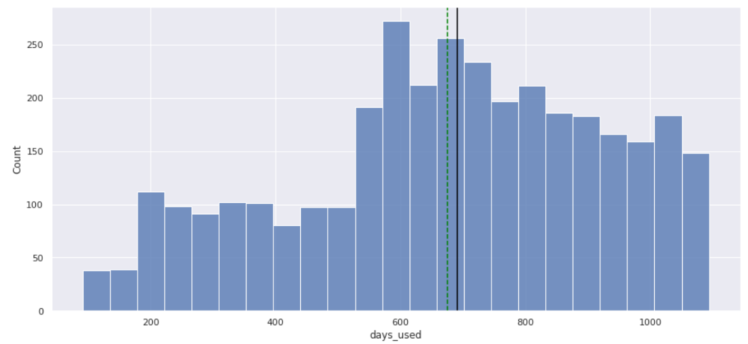
EDA Results
Univariate Analysis- Days Used
The distribution for days used is devoid of outliers
The plot is skewed to the left
The average number of days which refurbished devices were used was for about 675 days.

Slide 19
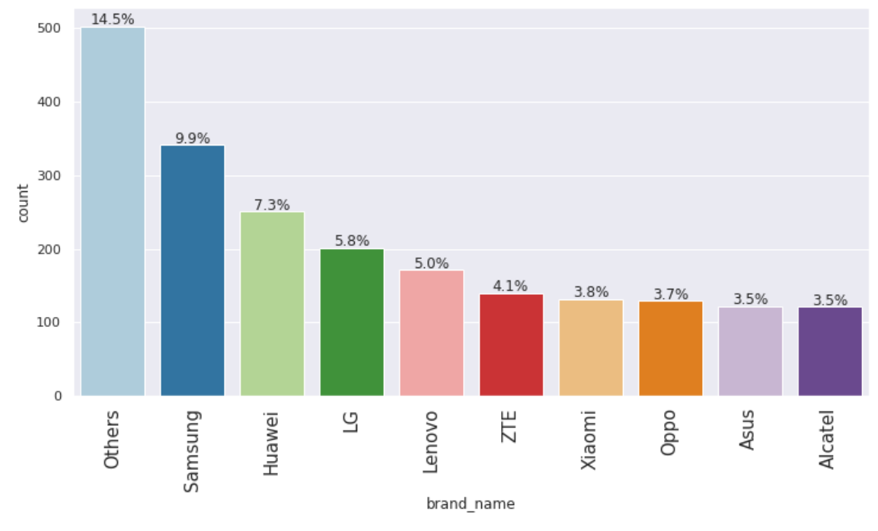
EDA Results
Univariate Analysis-Brand name
Others are brand names which make up 14.5% of the refurbished devices followed by Samsung at 9.9%.
Alcatel and Asus make up 3.5% of the refurbished or used devices.

Slide 20
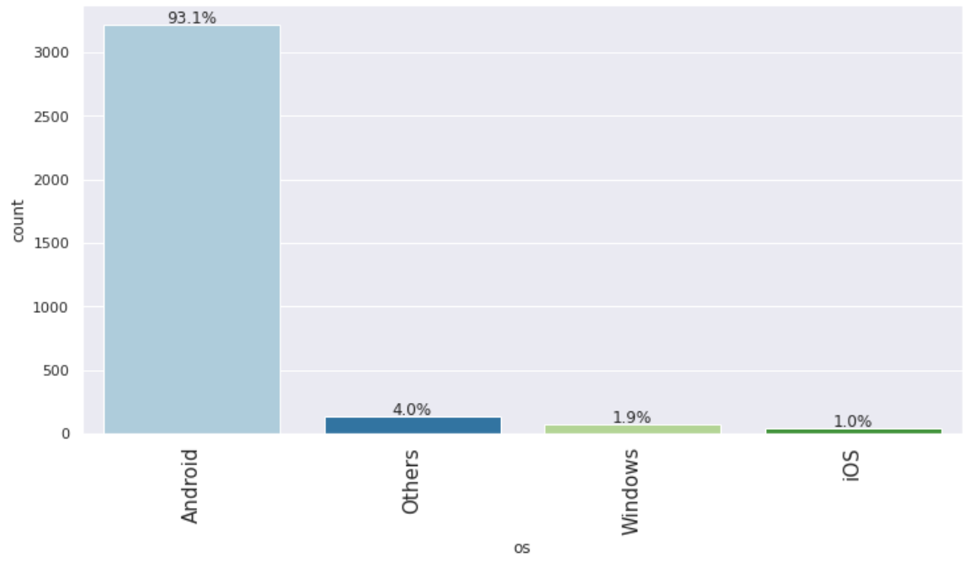
EDA Results
93.1% of the refurbished/used phone use Android OS while just 1% of the refurbished phones use IOS Operating system
Univariate Analysis- os

Slide 21
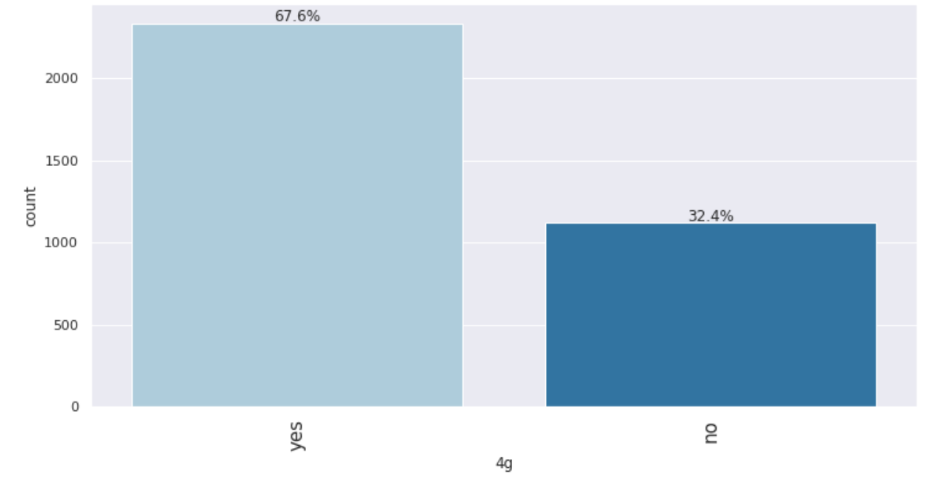
EDA Results
Univariate Analysis- 4g
In this distribution for 4g we can see that 67.6% of the refurbished devices have 4g network while the remaining 32.4% do not have 4g network.

Slide 22
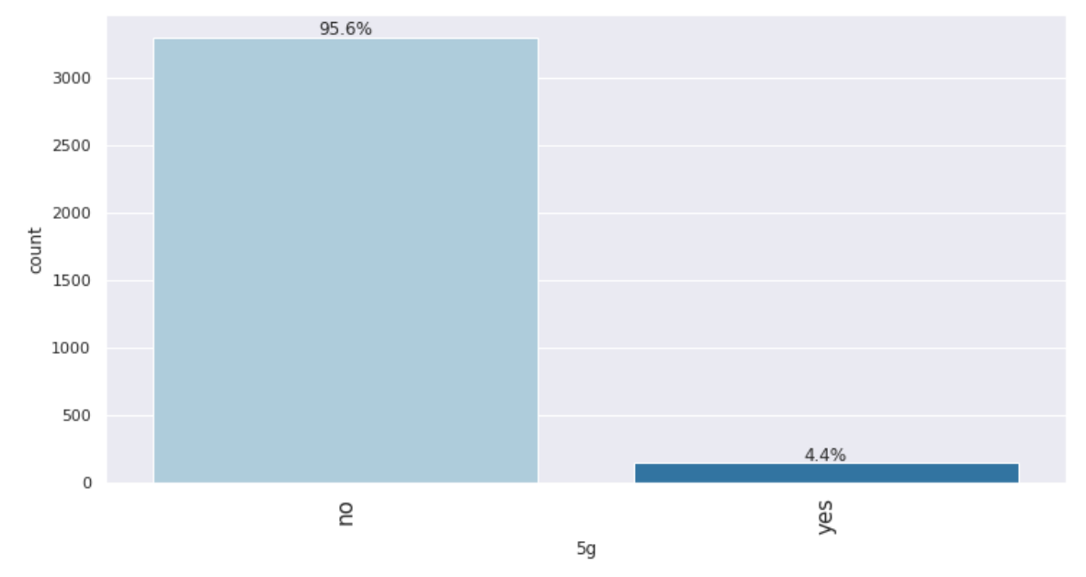
EDA Results
Univariate Analysis- 5g
In this distribution we can see that 95.6% of the refurbished devices have 5g network while the remaining 4.4% do not have 5g network. This means that a good number of the refurbished phones have very good network .

Slide 23
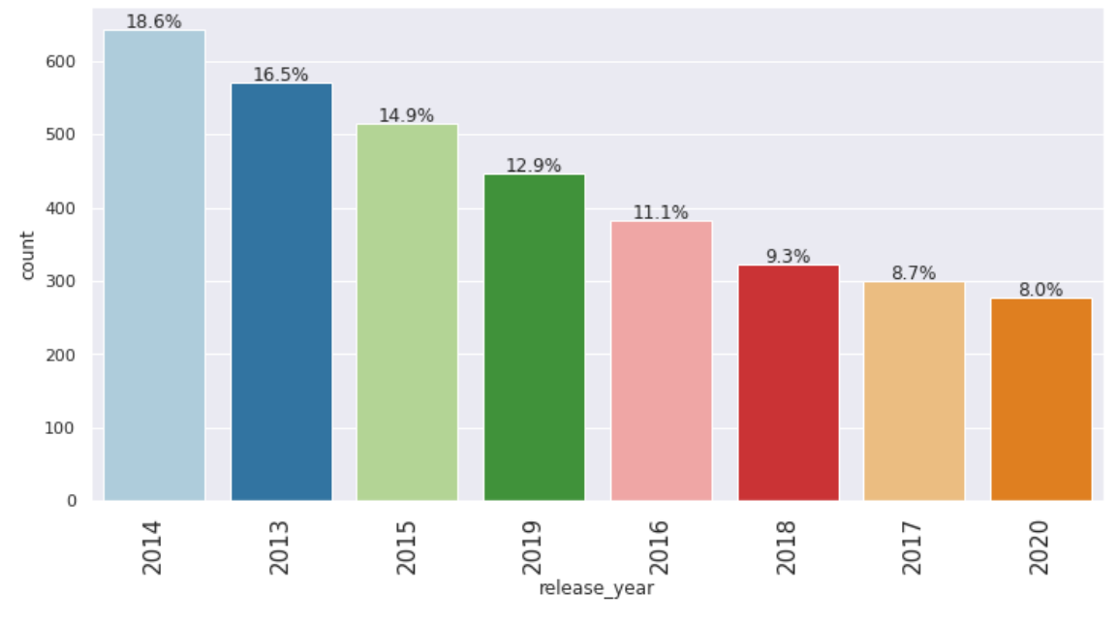
EDA Results
Univariate Analysis- release year
In 2014, 18.6% of the model devices were released while 8% of the model devices were released in 2020. The earliest release year was in 2013.

Slide 24
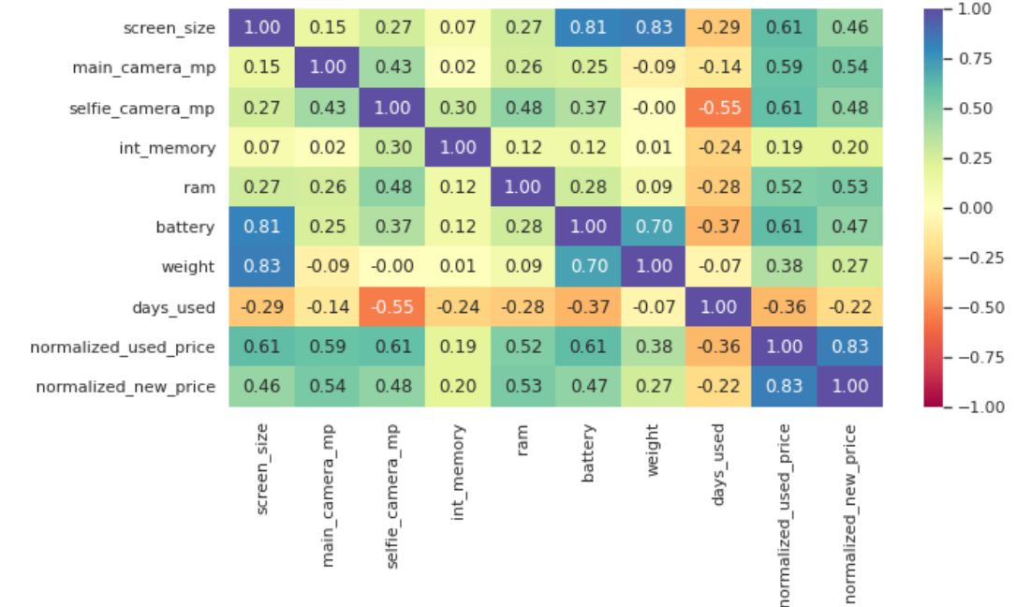
EDA Results
Bivariate Analysis- Correlation check between variables
It is good sign when the dependent variables have good correlation with independent variables.
We can see some high positive correlation between normalised used price and normalised new price and a very low negative correlation between normalised used price vs. days used.

Slide 25
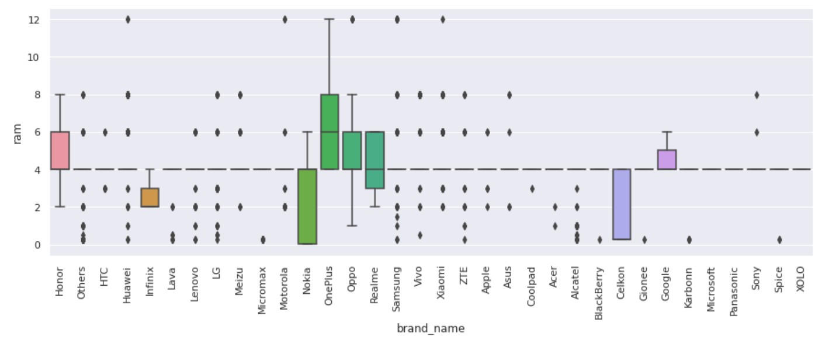
EDA Results
Bivariate Analysis- ram vs. brand name
One plus device has the largest ram size while Nokia and Celkon have the lowest ram
There are many outliers present in this distribution

Slide 26
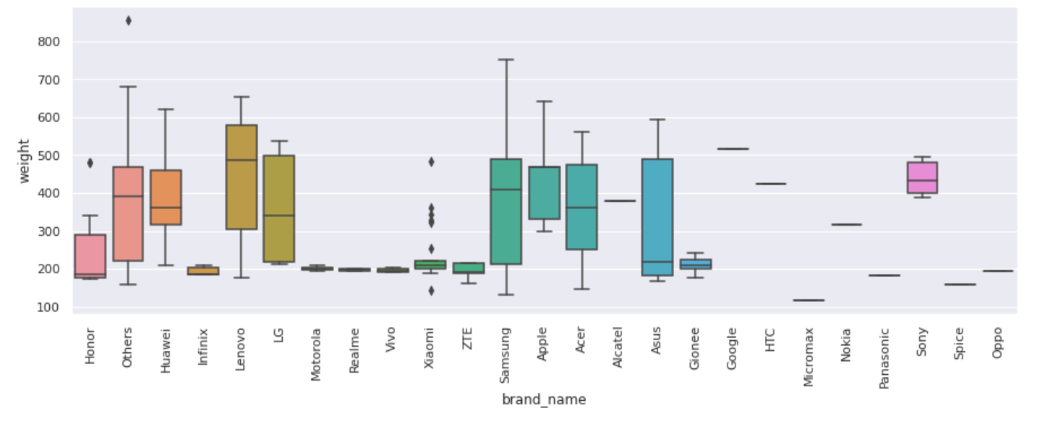
EDA Results
Bivariate Analysis- weight vs. brand name
Samsung device weighs the heaviest, followed closely by Others, Lenovo, Apple while Infinix, ZTE and Gionee weigh about 200 grams.
Some outliers can be seen on Xiamoi device.

Slide 27
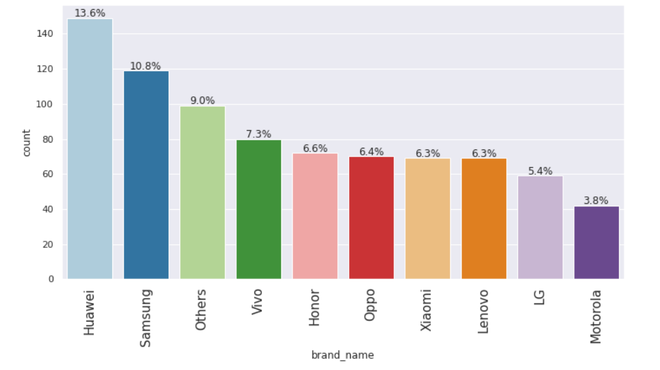
EDA Results
Bivariate Analysis- brand name in large screen dataframe
Huawei device has the largest screen size followed closely by Samsung while Motorola makes up 3.8% of devices with large screen.
Link to Appendix slide on data background check

Slide 28
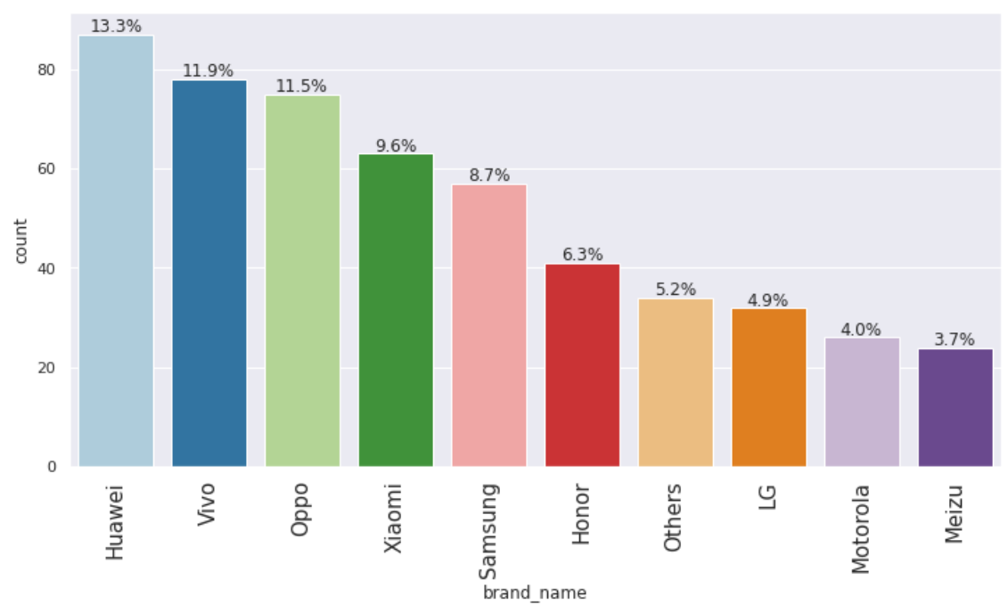
EDA Results
Bivariate Analysis- brand name in selfie camera dataframe
Huawei makes up 13% of devices with good front camera for taking selfies while Meizu makes just 3.7% of devices with good selfie camera.

Slide 29
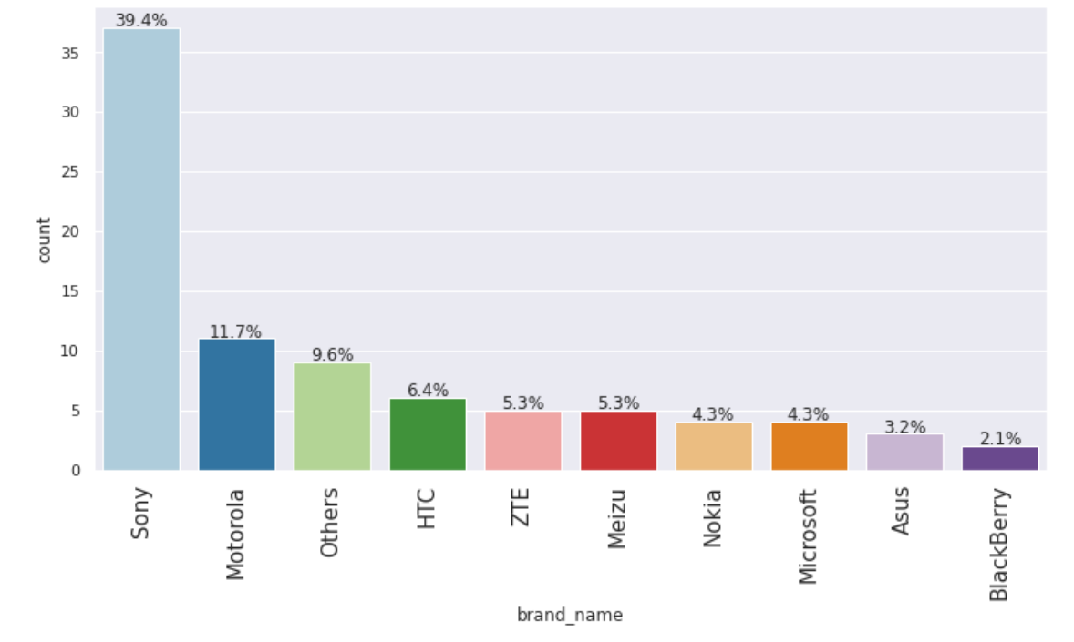
EDA Results
Bivariate Analysis- brand name in main camera dataframe
Sony device stands out as the device with the best resolution for its rear camera while Blackberry has the lowest resolution. This can actually be one of the reasons Blackberry is hardly used as compared to Sony and Motorolla.

Slide 30
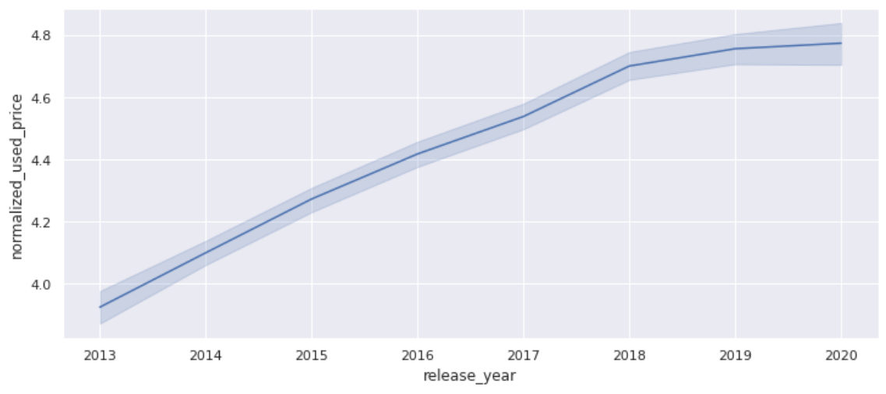
EDA Results
Bivariate Analysis- Normalised used prices over the release years
Over the years there has been a steady upward trend on the prices of used or refurbished mobile devices

Slide 31
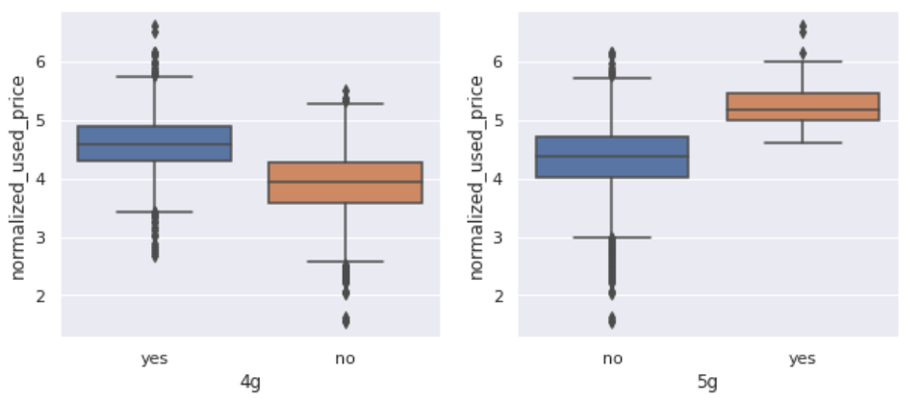
EDA Results
Bivariate Analysis- Prices vary for used phones and tablets offering 4G and 5G networks.
Devices which have 4g available are priced higher than those who don’t have.
Devices which have 5g available are also priced higher than those don’t have the 5g network.
Between 5g and 4g, devices with 5g network are priced higher than those with 4g network.

Slide 32
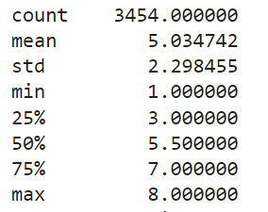
Data Preprocessing
Duplicate value check- The dataset was checked for duplicates but none was found
Missing value treatment- A number of missing values were found in our dataset, the variables with missing values are six in total. All missing values were treated accordingly by grouping the variables accordingly, using fillna and transform median method, (please see in appendix)
Feature engineering: We created years since release column and described it, see output below:
Years Since Release
The mobile devices have average number of 5 years since release date.
The longest period since release of the mobile devices is 8 years.
The shortest period for year since release is 1 year.

Slide 33
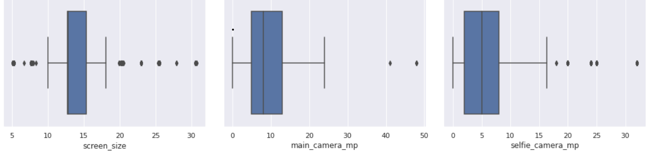
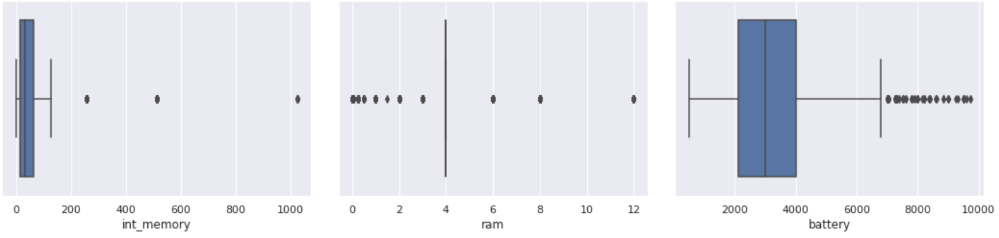
Data Preprocessing
Outlier Check
There were presence of outliers detected on boxplots, however they were not treated.

Slide 34
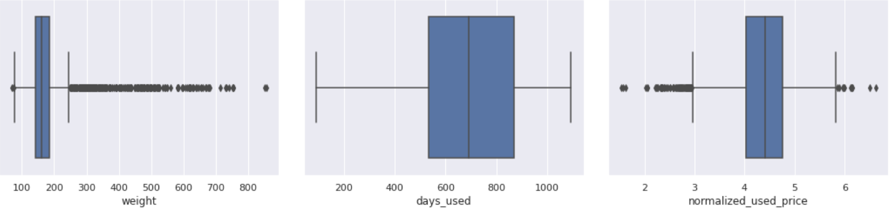
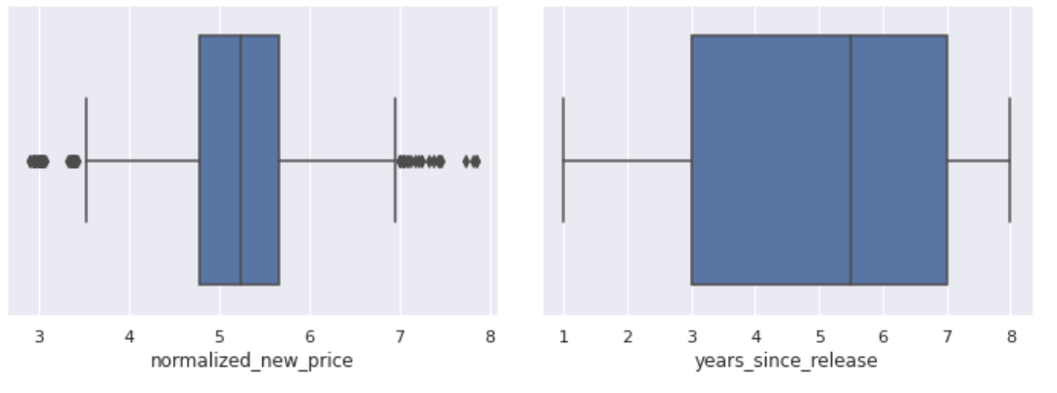
Data Preprocessing
Outlier Check
Days used and years since release columns do not have outliers

Slide 35
Data Preprocessing
Data Preparation for Modelling
I want to predict normalised price of used devices, therefore this is our dependent variable or target variable while the rest of the variables are predictors or independent variables.
So I defined my dependent variable and independent variable (see in appendix).
I added intercept to data.
All categorical variables were hot encoded, they include; brand names,4g, 5g and OS (operating system). I created dummy variables for them.
We split the dataset into test and train sets for model evaluation.
I then built a linear regression model using the train data

Slide 36
Model Performance Summary
Overview of ML model and its parameters:
Machine Learner makes no assumption where data is gotten from so we split our dataset in 70:30 ratio for train to test data and carry our model evaluation.
We will look at the following parameters:
-R squared and Adjusted R squared
-Constant cofficient
-Cofficients of all the predictor variables
Summary of most important factors used by the ML model for prediction
We will use the functions defined in sklearn for RMSE, MAE and R squared
Then define functions to calculate MAPE and adjusted R squared
To define function to compute metrics to check our performance of the regression, we define:
model: regressor
predictor: independent variable
target.: dependent variable

Slide 37
Model Performance Summary
Summary of key performance metrics for training and test data in tabular format for comparison
Performance metrics for training data | Performance metrics for testing data
olsmodel_train_perf | olsmodel_test_perf
model_performance_regression | model_performance_regression
olsmodel | olsmodel
x_train | x_test
y_train | y_test
Then take note of Rsquared to ensure model is not underfitting
Compare the test and train RMSE and MAE to check if model is overfitting
Check that the model is predicting the normalised used price with the right mean error on the test data
The MAPE value on the test data ensures that we are predicting within the value of our normalised used price.

Slide 38
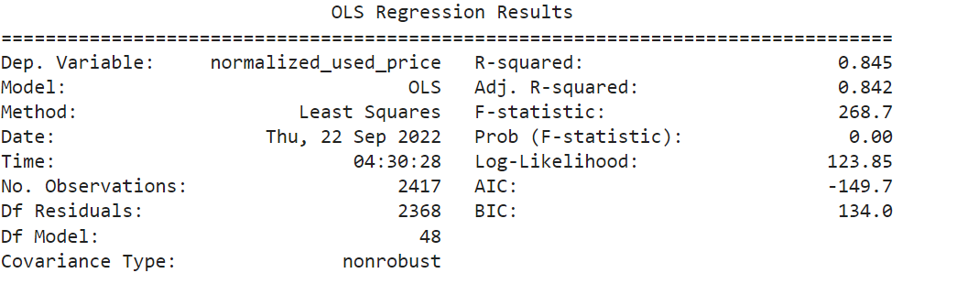
Model Performance Summary
Model 1- olsmodel1
R-square - 0.845
Adjusted R-square-0.842
The R-squared value tells us that our model can explain 84.5% of the variance in the training set.

Slide 39
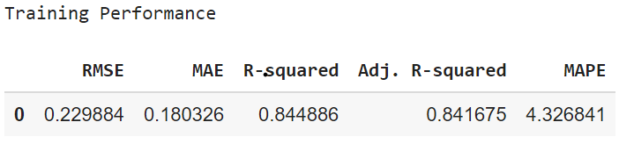
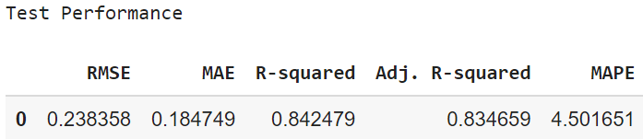
Model Performance Summary
Checked our model performance on train set (70% data) and performance on test data(30%)
Judging by how closely comparable our training and testing performance data values are, I can say that our data is neither overfitting nor underfitting. It is doing great.
Our training R-squared is 0.84.
Our MAE is 0.18 so our model can predict normalised prices for used phones with a mean error of 0.18 on our test data.
MAPE on the test data is 4.5, therefore we can predict with 4.5% of the used prices

Slide 40
APPENDIX

Slide 41
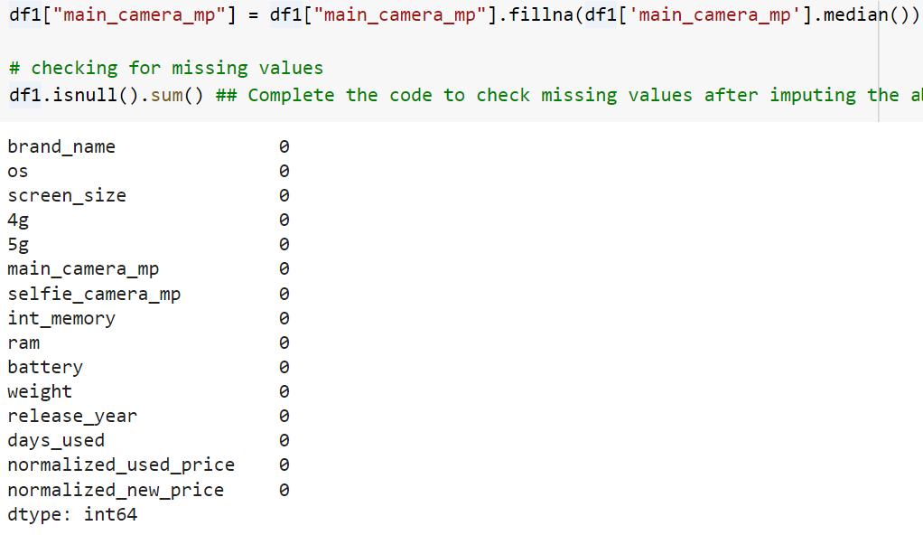
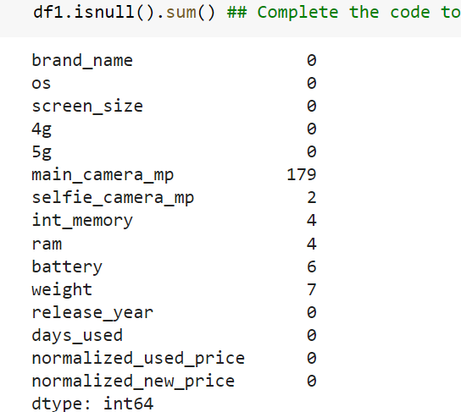
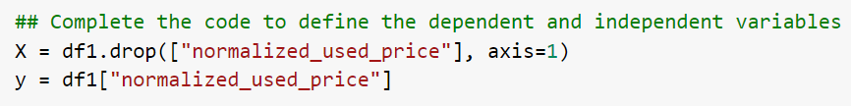
Data Background and Contents
Missing value treatment
Define our variables

Slide 42
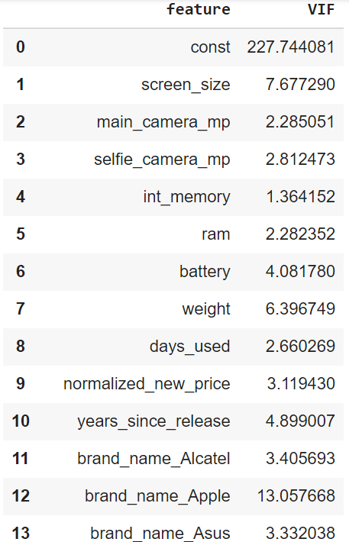
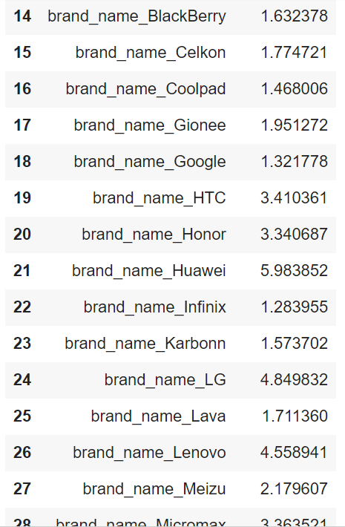
Data Background and Contents
Vif table

Slide 43
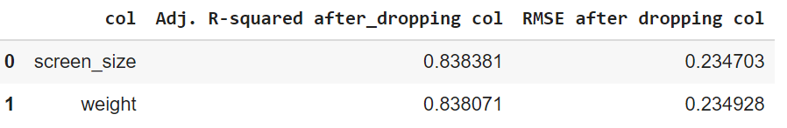
Model Assumptions
Multicolinearity Test
Defined function to check VIF and check my VIF on train data (see appendix)
Results: Presence of collinearity in screen size (VIF=7.67) and weight (VIF=6.40)
I ignored other variables with VIF>5 because they are dummy variables and categorical variables
Defined function for treating multicollinearity and treated it
Result:
I dropped weight because it makes the least change in adjusted R-squared.
I checked VIF again to confirm and no numerical value of interest has VIF>5
Multicolinearity has been dealt with.

Slide 44
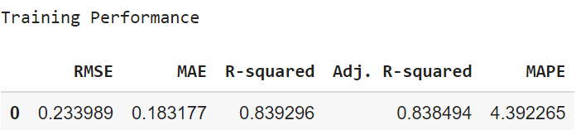
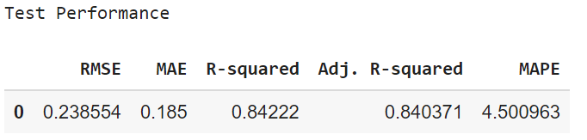
Model Assumptions
High p-value check – Creating olsmodel2
P-value>5 is dropped just to ensure so we created a new model olsmodel2 (without dropped feature-weight) to check if there’s any high p-value encountered.
I checked model performance on training and test sets.
Observations
None of the features has pvalues> 0.05, therefore, the features in x_train3 is considered as the final set of predictor variables while olsmodel2 becomes the final model to move forward with.
The adjusted R-squared is 0.839, which makes our model able to explain 84% of the variance.
The adjusted Rsquared in olsmodel1 (where we considered the variables without multicollinearity) was 0.842, which confirms that the weight variable dropped is not affecting the model
RMSE and MAE values are comparable for train and test sets, indicating that the model is not overfitting.

Slide 45
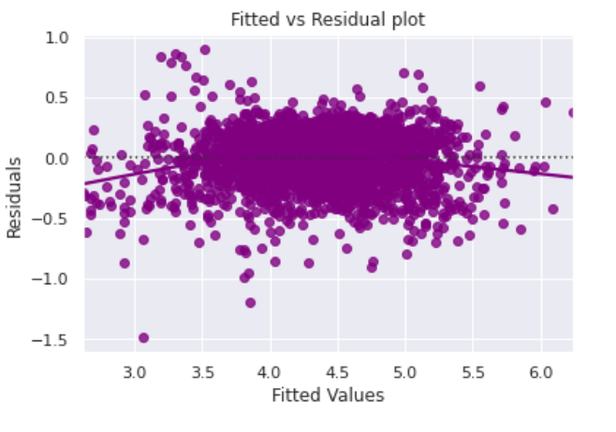
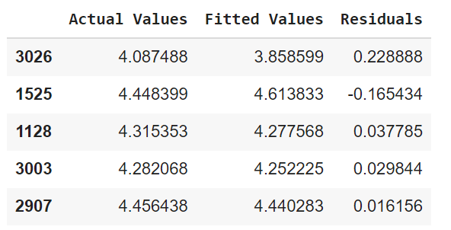
Model Assumptions
Linearity Test
I tested for linearity and independence by making a plot of fitted values (predicted values) vs residuals (errors) and checking for patterns.
There is no pattern, therefore I can say that the model is linear and residuals are independent, therefore my assumption has been met.

Slide 46
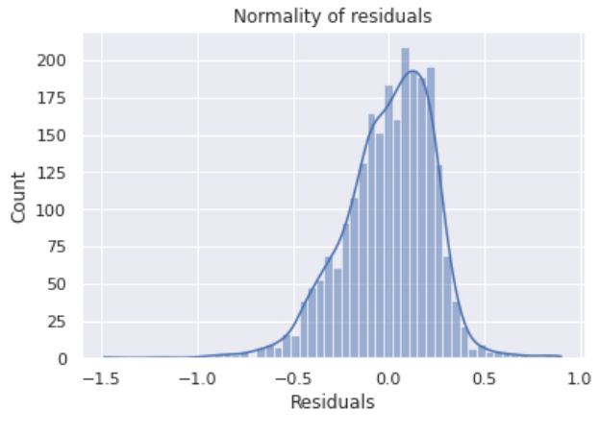
Model Assumptions
Normality Test
I carried out all the 3 tests which include distribution of residuals, Q-Q plot of residuals and Shapiro Wilk test.
Distribution of residual plot
Observation:
The histogram of residuals does not have a fully bell shape but is tending towards the bell shape and therefore can be said to have attained normality, therefore assumption is satisfied.
Let's check the Q-Q plot.

Slide 47

Model Assumptions
Normality Test
Q-Q plot
Shapiro Wilk test
Since the p-value < 0.05, the residuals are not normal.
Result
We can approximate and accept Q-Q plot, distribution and Shapiro as close to being normal.
Therefore the assumption is satisfied
Most of the residuals appear to be on the straight line except the tails which are dipping away.

Slide 48

Model Assumptions
Homoscedasticity Test
I carried out this test using the goldfeldquant test to ascertain that we get a pvalue>0.05.
Since p-value was 0.1752 and > 0.05, we can say that the residuals are homoscedastic. So, this assumption is satisfied.
So I moved on to predictions
Result of prediction on test set
Observations
Here we can see that our model has returned some good prediction results, where the actual and predicted values are comparable.
I moved on to the final model

Slide 49



Final Model
Final model- olsmodelfinal
Result interpretation:
Our model is able to explain 84% of the variation in the data.
The train and test RMSE and MAE are low and comparable which signifies that our model is not suffering from overfitting.
The MAPE on the test set suggests we can predict within 4.5% of the normalised used price.
Hence, we can conclude the model olsmodel_final is good for both prediction and also inference purposes.

